Slide 1
Project Procurement Risks
“Risk management. . . is the art and science of identifying, analyzing
and responding to risk factors throughout the life of a project and in
the best interests of its objectives”
Lecture 6

Slide 2
The Management of Project Procurement Risks
Why Manage Risks?
  It is a fact of life that chance events will occur and affect the outcome of your contract
  Murphy’s Laws codify this “knowledge”
    If anything can go wrong, it will!
    Of things that could go wrong, the one that causes the most damage will occur!
The matter of risk, the possibility that something may go wrong, or may not happen as planned, is an essential part of effective project management.
Risk management attempts to identify such events, minimize their impact & provide a response if the event is detected
  The essence of contract Management is Risk Management!

Slide 3
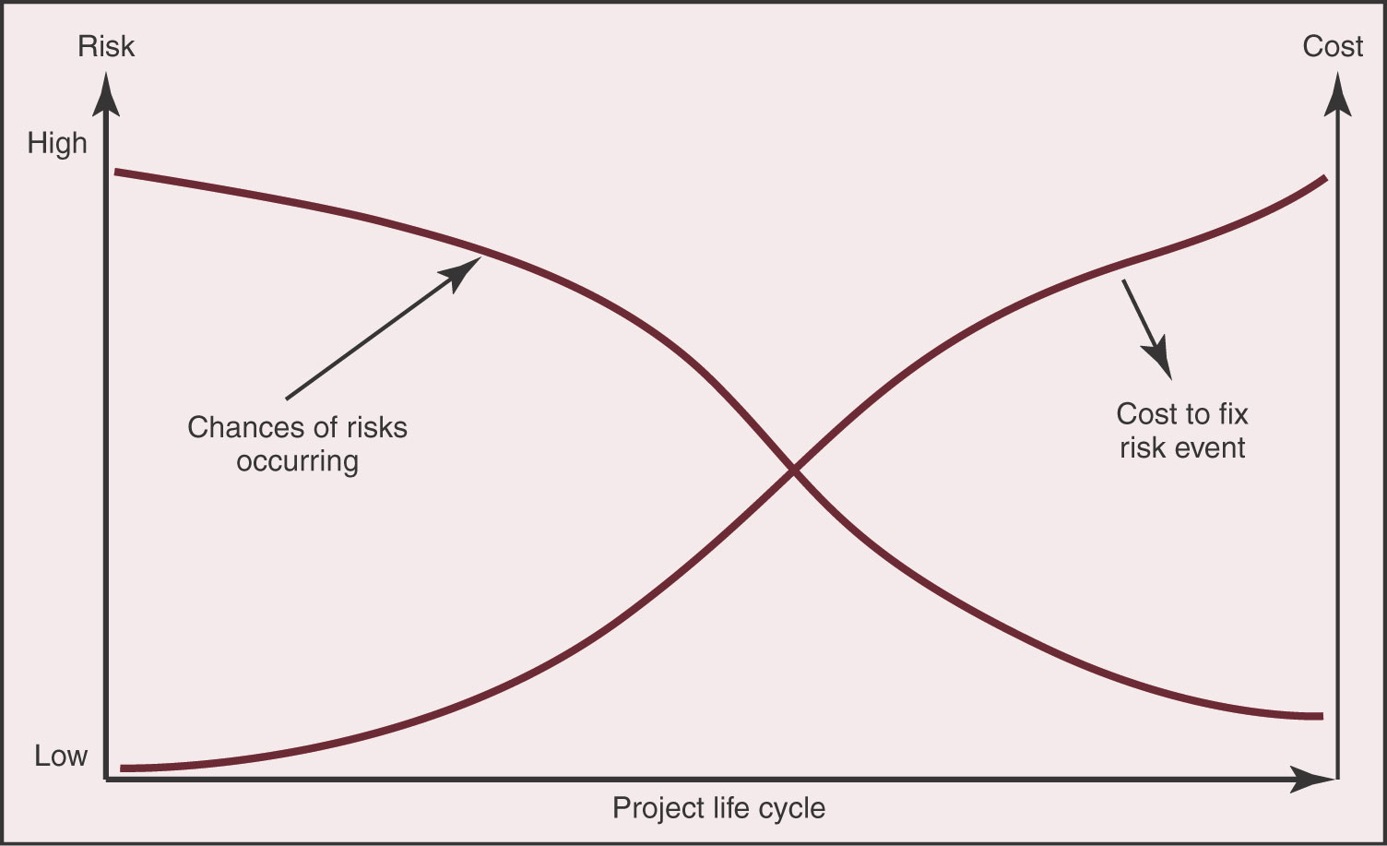
Risk During Contract
Risk and the associated cost to address the risk, varies over the contract life cycle
  For initial phase there is high chance of risk events, but low cost impact
  For final phase there is low chance of risk events, but cost impact is high
Identifying and managing risks will greatly affect contract success

Slide 4
Rationale for Assessing Risk
The project risk management process is needed to ensure that:
  All significant risks to the success of the project are identified;
  Identified risks are understood, with both the range of potential consequences they represent and the likelihood of values in that range being determined as far as is necessary for decision-making;
  Assessment is undertaken of individual risks relative to the other risks to support priority setting and resource allocation;
  Strategies for treating the risks take account of opportunities to address more than one risk;
  The process itself and the risk treatment strategies are implemented cost-effectively.

Slide 5
What is Risk Management
Risk: Possibility of loss or injury, a dangerous element or factor, the chance of loss, the degree of probability of such loss.
Risk Identification: The process of systematically identifying all possible risk events which may impact a project.
Risk Assessment: The process of subjectively determining the probability that a specific interplay of performance, schedule, and cost, as an objective, will or will not be attained along the planned course of action.
Risk Management is the systematic process of identifying, analyzing, and responding to risk. It includes maximizing the probability and consequences of positive events and minimizing the probability and consequences of adverse events to project objectives

Slide 6
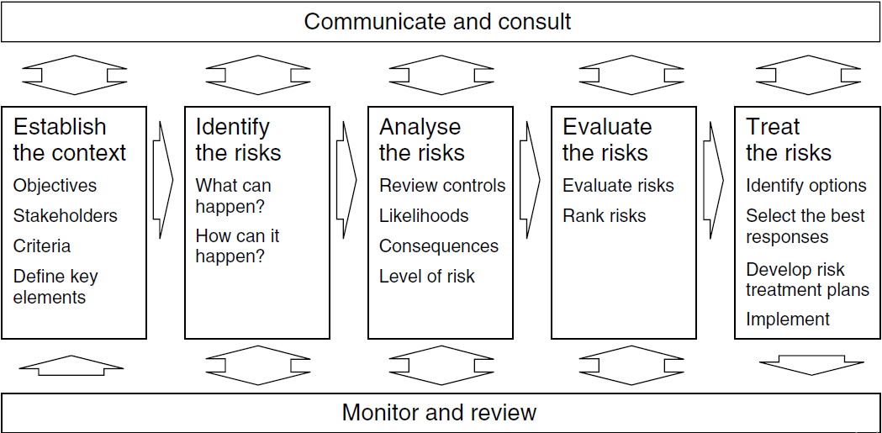
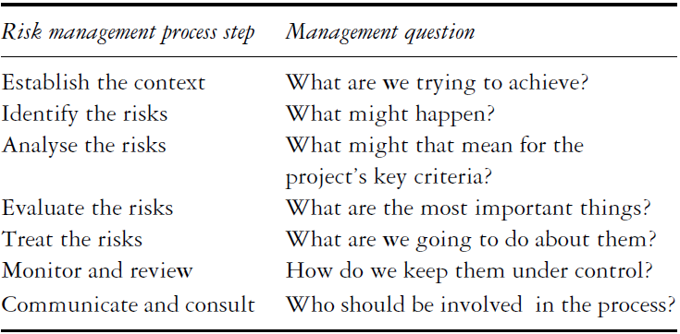

Slide 7
Risk Categories
Risks associated with the technical aspects of a contract can have the most severe outcomes
  Can be mitigated by building and testing prototypes of critical components
  Have available backup or alternate designs that have much lower risk
Risks associated with the schedule usually require a trade-off
  Manage “slack” time to provide resources for delayed components
  Bring in more people (increase costs) or reduce performance
Risks associated with costs usually result from estimate errors and omissions
  Time & cost are related; trade-off schedule delays with lower cost
  “Descope” options that remove components of the contract, but still allow the primary mission to proceed
All “budgets” should include a reserve percentage that can be expended as risk events occur

Slide 8
For some projects, risk management may be a formal requirement at specific stages of the project development. There may be many reasons for this:
Economic viability assessment, for high-level strategic decision-making about whether or not to proceed with a project;
Financial feasibility assessment, when a finance package is being assembled;
Corporate governance and accountability, for managers, project staff, end-users and suppliers to demonstrate that they have fully assessed all the material risks, that the measures taken to control risk are appropriate, and that the economic reward for taking on the risk that remains is adequate;
Contractual purposes, to assess alternative contractual and legal frameworks for the project, in the context of deciding who should bear what risks and determining an equitable allocation and sharing of risks and rewards between the parties involved;
Tendering, when deciding whether or not to bid, or accept a bid, for a proposed project, and in what form;
Regulatory purposes, for legislative, judicial or licensing agencies, or for public inquiries, to demonstrate accountability in a public or social context;
Communication purposes, to provide information for owners, sponsors, users, contractors, joint venture partners or other stakeholders, or to demonstrate capability and competence in an area.

Slide 9
Steps in Risk Management
The Identification of potential project risks
The Assessment of the probability of a risk's
The Development of a risk closure plan

Slide 10
The Identification of Potential Project Risks
1. WBS (Work-breakdown Structure)
Breaking the project into manageable pieces (WBS elements) exposing the critical stages within each WBS elements.
2. Brainstorming
The initial goal of the Brainstorming approach is to develop a comprehensive listing of all possible risks facing the new project, but not necessarily to immediately resolve them.
In Brain Storming the facilitator, the official scribe and the team is involved who identifies the risk that can occur during any stage of the project.

Slide 11
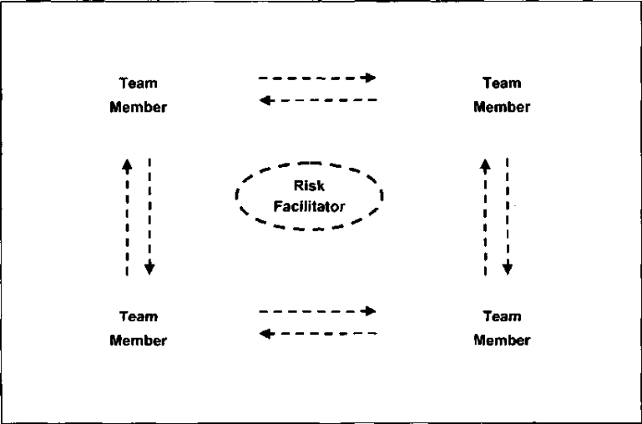
The Identification of Potential Project Risks
3. The Delphi Technique
  A risk facilitator will be selected. This is typically a person who is an expert in research data collection, but not necessarily in the project itself, he will create a list of risk associated with project, another panel of team members or experts will be formulated and the facilitator will ask this panel to rank the preliminary risk criteria according to some designation such as:
  (1) a very critical risk,
  (2) a somewhat critical risk, or
  (3) not a critical risk issue.
The panel will be asked to respond and the facilitator will compile the inputs and will come with new list of risk and will continue the process until the results shows the consensus of experts about risk.

Slide 12
The Identification of Potential Project Risks
4. Interview
In this process risk identification is directed to specific individuals who are considered to be experts in a particular project, or perhaps the technology of the project.
They have been there before, and have valuable experiences to share. They do not necessarily have to be working on the project.
The interviewing process can be performed to both identify new risks, and also to assess the risks identified earlier using Brainstorming or the Delphi Technique.

Slide 13
Assessing the Risk Impact
Not all risks need to be subject to monitoring and control
Use a Scenario Analysis to assess the risk event impact
  Determine all consequences and their severity if the event happens
  Identify when, during the contract, will the event likely happen
  Estimate the probability that the risk event will occur
  Determine how difficult it will be to detect the event occurrence

Slide 14
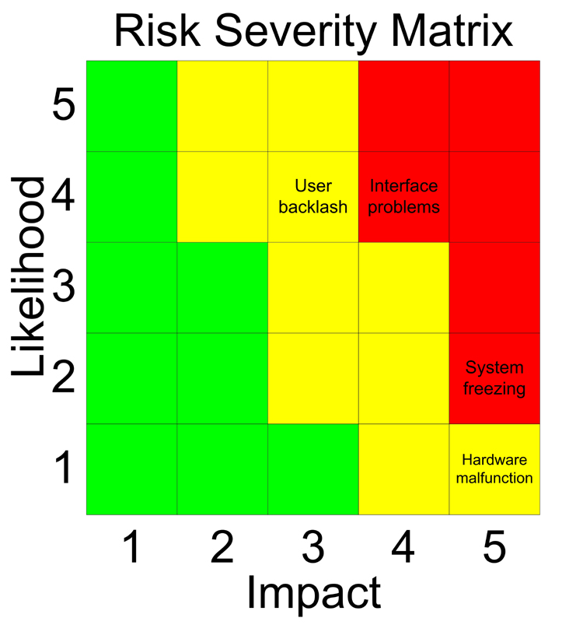
Ranking the risk importance
Rank risks from those that can be neglected to those that require elevated vigilance
A Risk Severity Matrix can be helpful in prioritizing risks
  Plot of event probability versus impact
Red zone identifies the most important events
Yellow zone lists risks that are moderately important
Green zone events probably can be safely ignored

Slide 15
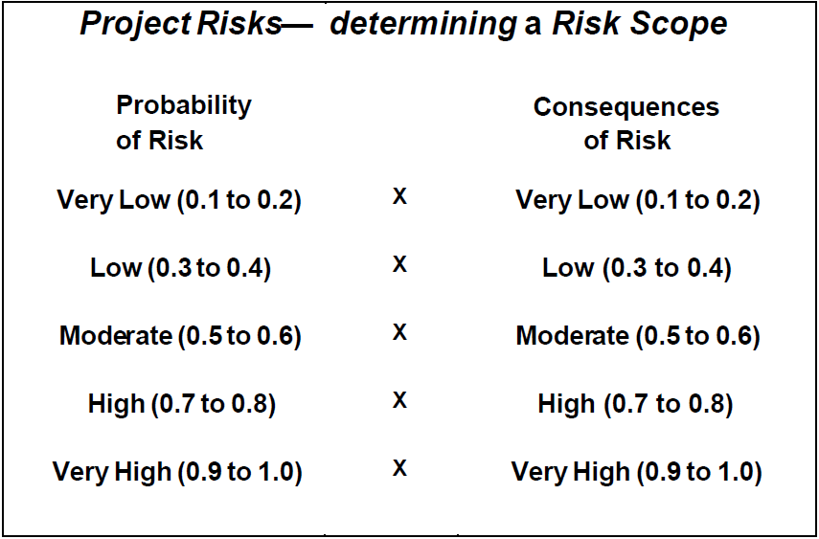
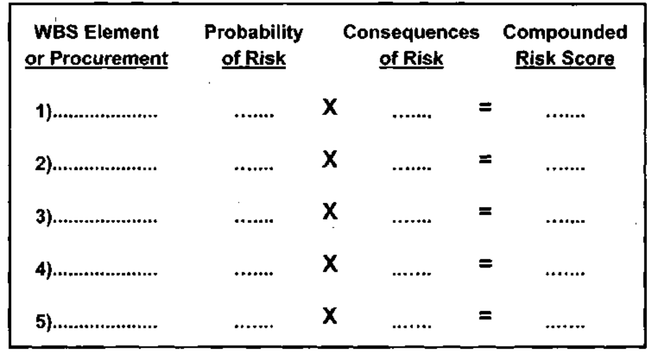
Quantitative Risk Analysis

Slide 16
Risk Response Strategies
Avoid Risk: Projects can sometimes eliminate identified risks through a reexamination of the requirements which may have caused the risk.
  Hiring/consulting experts
  Pre-qualification/Request for Proposal (RFP) for solicitation
Mitigating Risk: Actions are taken during the contract to either reduce the likelihood of a risk or reduce the impact of the risk:
  Adding additional product testing, proofing, prototyping, are all risk mitigation strategies
  Employing only experienced personnel, using only proven suppliers, will mitigate risks.
  Inserting incentive performance provisions into contracts with sellers can sometimes help.
  For example, testing electrical components after receipt would reduce the likelihood that “bad” parts would be used in a circuit

Slide 17
Risk Response Strategies
Sharing or Transferring Risk
  Using contract types to shift and share risks in complex procurements.
  Using terms such as “Liquidated Damages” and other techniques such as buying performance insurance, bonding, guarantees, and warranties
  Many companies in an attempt to reduce their risk exposure will form strategic joint ventures, sometimes called teaming agreements to spread or share the risk.
Accept the Risks
  This last approach is the one taken when all else fails. Sometimes risks cannot be eliminated altogether. The only option for the project is to lice with the condition
  Risk contingency plans will be made, but the identified risks cannot be eliminated completely.

Slide 18
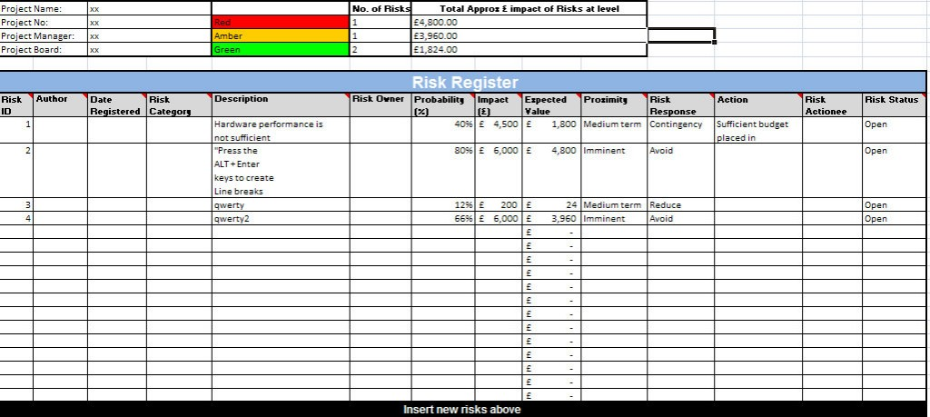
Developing a Risk Register!

